Slide 1
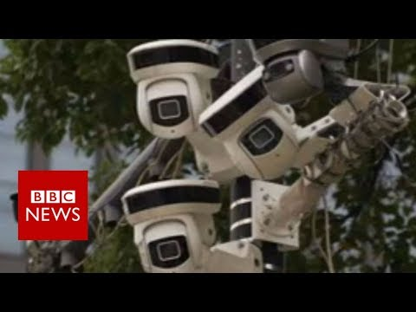
China: "the world's biggest camera surveillance network" - BBC News

Slide 2
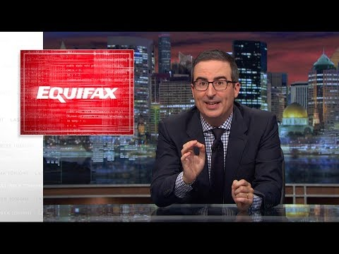
Equifax: Last Week Tonight with John Oliver (HBO)

