Slide 1
Human Rights, Digital Rights, and Security:
Public Policy for the 21st Century Cyberspace
Paulina Valdivieso

Slide 2
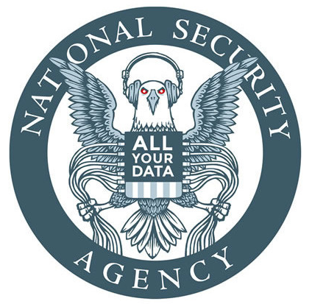
Background: USA
NSA
First Unitarian vs NSA, Hepting vs AT&T, Smith vs Obama
Carpenter vs the United States, Olmstead vs the United States
Ad Market
Data Breaches (Equifax, Facebook, NewEgg, Quora…)
Google monopoly

Slide 3
Background: UK
GCHQ
Cambridge Analytica
Belgacom Incident

Slide 4
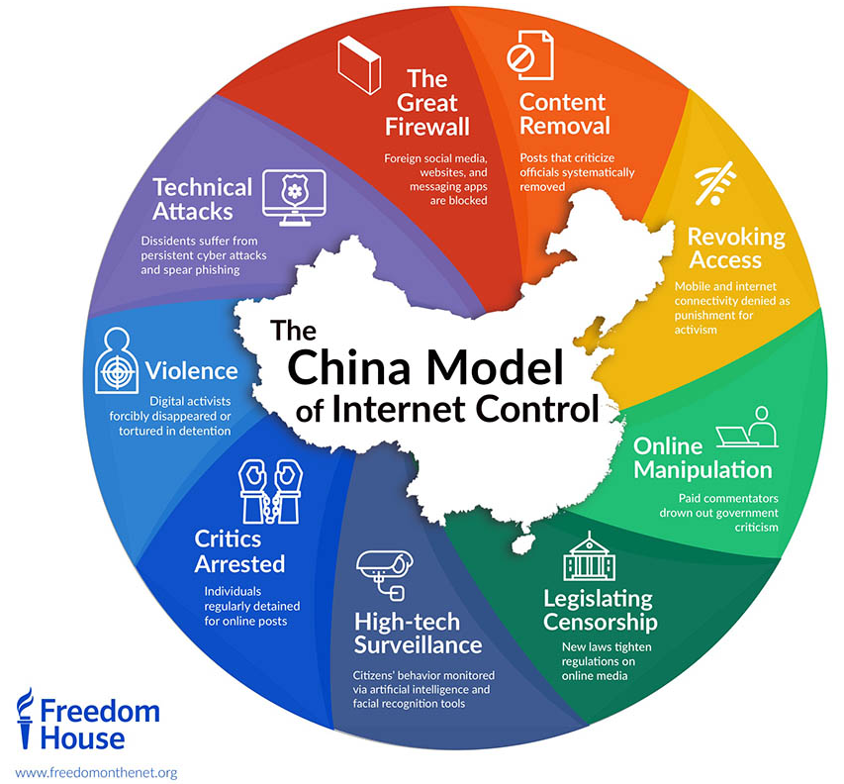
Background: China
Real-World Panopticon
Camera Tracking
Website Access Control
Work with Google
VPN Restriction
Biggest Tech Producer
And many more...

Slide 5
Conflict: Russia & Ukraine
Started as an armed conflict
Attacks to infrastructure and allies
NotPetya
Soldiers without insignias, policy has no protocol for that
This mimics the online behaviour of anonymization

Slide 6
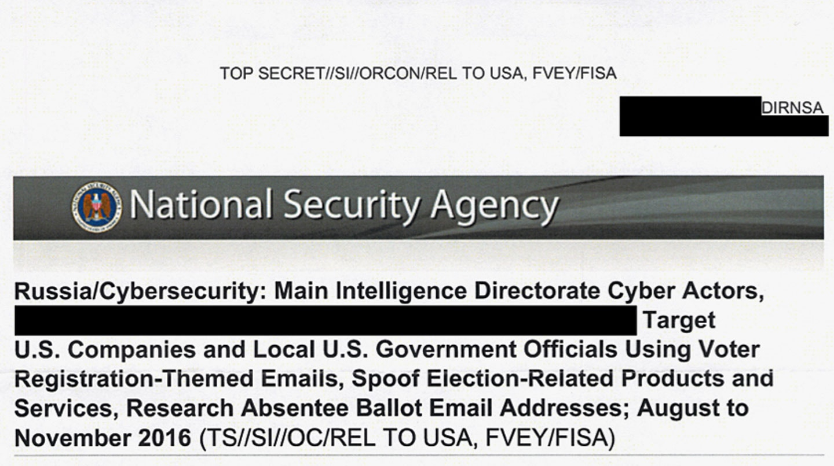
Conflict: Russia & USA

Slide 7
Conflict: Russia & USA
2016 Election Meddling
AntiVacs, 4Chan, Twitter…
Guccifer 2.0
Misinformation campaigns
Partisanship and the redefinition of identity

Slide 8
But this is all politics!
Where are the human rights?
Countries’ conflicts and foreign policy can and will change what they do, what is legal, what they repress.
Human rights can be violated indirectly
Orwellian dystopias are not a myth

Slide 9
Program: Five Eyes
USA, UK, Canada, Australia, New Zealand
Shared resources for mass surveillance
Collaboration
Arrest of Huawei CFO as a diplomatic incident
ECHELON
Industrial Espionage
"supra-national intelligence organisation that doesn't answer to the laws of its own countries" - Edward Snowden
Sed quis custodiet ipsos custodes?

Slide 10
Examples...
Spied on two British cabinet ministers in 1983.
Spied on and intercepted the phone calls of Diana, Princess of Wales, up until the moment of her death (1997). Classified as top secret as "... they could cause exceptionally grave damage to the national security ... the documents would disclose 'sources and methods' of U.S. intelligence gathering"
Monitored the conversations of the 7th Secretary-General of the United Nations Kofi Annan.
Gathered "detailed biometric information" on the 8th Secretary-General of the United Nations, Ban Ki-Moon.
Exposed bribing from european Airbus to Saudi Arabia, to benefit american Boeing
Eavesdropped on the conversations between Japanese bureaucrats and executives of car manufacturers Toyota and Nissan to boost America’s trade negotiations.

Slide 11
What does this all mean?
Attacks to civilian resources are normally an act of war
If an oil rig or a coal mine is destroyed, it’s very much of a big no
If a server or service is destroyed/attacked, there is no consequence
Destabilization of structures, civilian and otherwise
Maersk, FedEx, Merck
Banking system (Ukraine)
Electoral system (USA)
Aviation (civilian and military)
Political agenda & psychological warfare
State sponsored hacking with plausible deniability
Inherent dehumanization and anonymization

Slide 12
What does this all mean?
Possibility of attacks to essential platforms (energy, medicine, food)
State structures heavily depend on private sector
Platforms depend on (unsafe) technology to run
No regulations or guidelines
Censorship and repression
Technological supremacy and new imperialism
Panopticon
Mass surveillance
Lack of definitions, language, accountability and repercussions for attacks
Can’t stop what is not recognized
Current policies do not account for changing landscape
Behaviour online is translated into state and personal behaviour (Russia example)

Slide 13
Example Scenario #1
State 1 is in conflict with State 2. State 1 wants to damage some of 2’s supplies or infrastructure to distract the enemy.
State 1 does some recon on what is the most important AND vulnerable and finds... Hospitals!
State 1 compromises hospitals and targets their records, ICSs (Industrial Control System), and machines. There is a generalized loss of life out of the mix up that doctors at first can’t recognize.

Slide 14
Example Scenario #2
State 1 is in conflict with State 2. State 1 wants attack State 2 without actually attacking because that would be problematic.
State 1 does some recon on what is the most sensitive AND vulnerable and finds... Nuclear power plants!
State 1 compromises power plants and messes with their ICSs and PLCs (Programmable Logic Controller) to get the machine in a positive feedback loop. No one realizes what is happening. By the point they detect it, there is irreversible damage.
Spoiler: this actually happened

Slide 15
Human Rights Violated or at Risk
Article 2: Everyone is entitled to all the rights and freedoms set forth in this Declaration, without distinction of any kind, such as race, colour, sex, language, religion, political or other opinion, national or social origin, property, birth or other status. Furthermore, no distinction shall be made on the basis of the political, jurisdictional or international status of the country or territory to which a person belongs, whether it be independent, trust, non-self-governing or under any other limitation of sovereignty.
Article 3: Everyone has the right to life, liberty and security of person.

Slide 16
Human Rights Violated or at Risk
Article 8: Everyone has the right to an effective remedy by the competent national tribunals for acts violating the fundamental rights granted him by the constitution or by law.
Article 12: No one shall be subjected to arbitrary interference with his privacy, family, home or correspondence, nor to attacks upon his honour and reputation. Everyone has the right to the protection of the law against such interference or attacks.

Slide 17
Human Rights Violated or at Risk
Article 19: Everyone has the right to freedom of opinion and expression; this right includes freedom to hold opinions without interference and to seek, receive and impart information and ideas through any media and regardless of frontiers.
Article 25.1: Everyone has the right to a standard of living adequate for the health and well-being of himself and of his family, including food, clothing, housing and medical care and necessary social services, and the right to security in the event of unemployment, sickness, disability, widowhood, old age or other lack of livelihood in circumstances beyond his control.

Slide 18
What are the implications?
Changes in the way war is fought, and policies not accounting for them
Technology is done through the private sector, the state does not protect it (despite relying on it)
There is no real way to protect everyone. Spillover and collateral damage are bigger, heavier and worse
Ultra dependency on internet is bad. No redundancy.
Dependency on technology that no one understands
What is an attack? Under attack, what does defense look like?

Slide 19
How do we fix this?
Should specific tools (mimikatz, stuxnet, etc) be considered weapons? (Yes)
State defense needs to account for private sector and potential spillover with international agencies, trade partners
Tallinn Manual 2.0
Wassenaar Arrangement
State regulations and Quality Assurance, in the same way that other sectors have them
“Cyber 911”
Redundancy, independence and mitigation of widely used services

